Slide 1
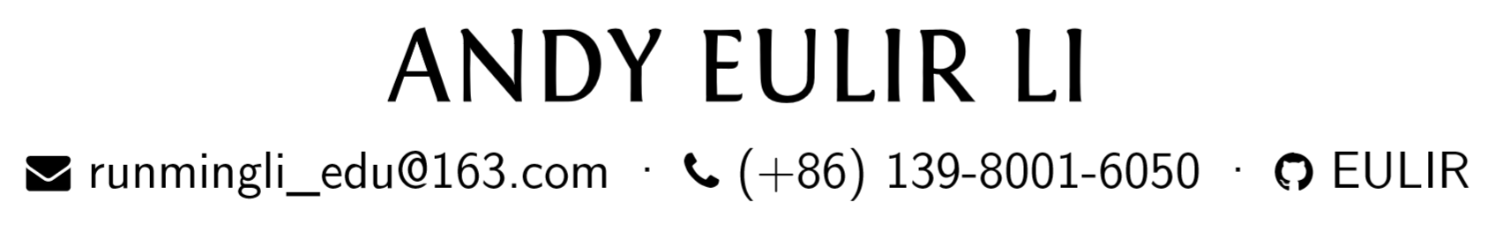
MAKE COMPUTER SCIENCE GREAT AGAIN
This work is licensed under a Creative Commons Attribution-NonCommercial-NoDerivs 2.0 Generic License.

Slide 2

What is Computer Science?
What is Computer Science Club?
Why we are here?
Where is our future?

Slide 3
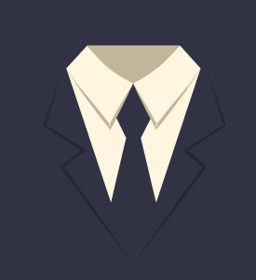
Post Cognition
Club
Club members
Previous club
Future club

Slide 4
Personal Profile
High school student at Chengdu No.7 High School.
Multilingual developer: experienced in Java/Kotlin/Pascal/Python, especially mastered in Java.
Website designer: experienced in HTML/CSS, especially mastered in website design under GitHub page.
Acting leader of Great China Computer Science Club: Launch club activities for more than eight times.

Slide 5
Open Source Contribution
500 contributions in the past 4 months on GitHub.
13 personal projects using 7 different languages.
See my open source contributions on
https://eulir.github.io/open-source-contribution/

Slide 6
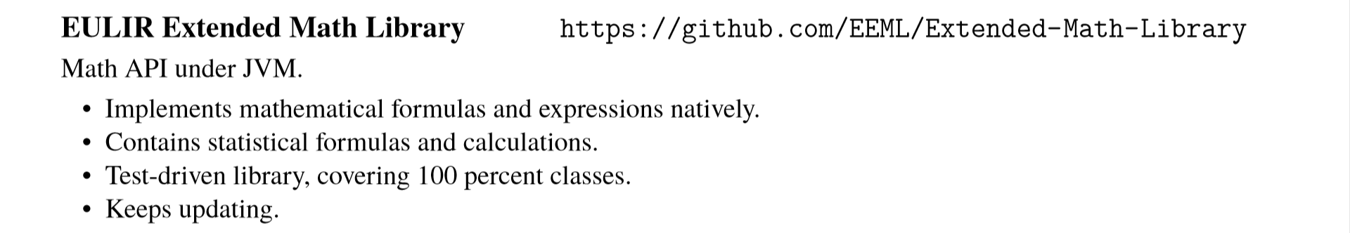

Personal Projects

Slide 7
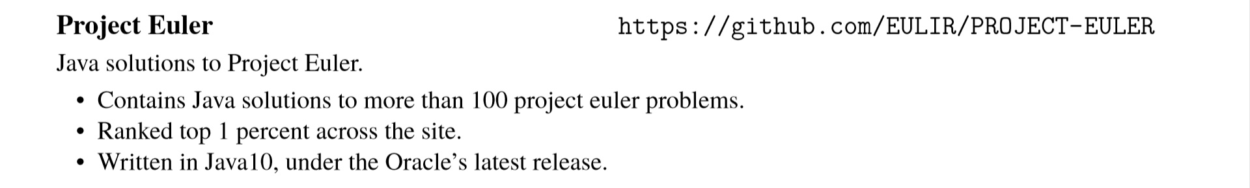
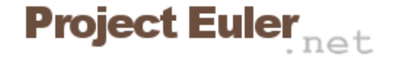
Personal Projects

Slide 8
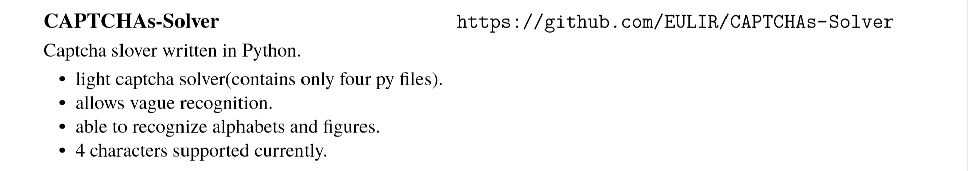
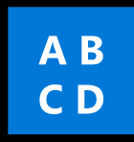
Personal Projects

Slide 9
Personal Projects
Website works:
Personal blog:
https://eulir.github.io/
Website of Computer Science Club:
https://greatchina-computerscienceclub.github.io/
Website of EEML:
https://eeml.github.io/
Blog template:
https://eulir.github.io/Blog-Template/

Slide 10
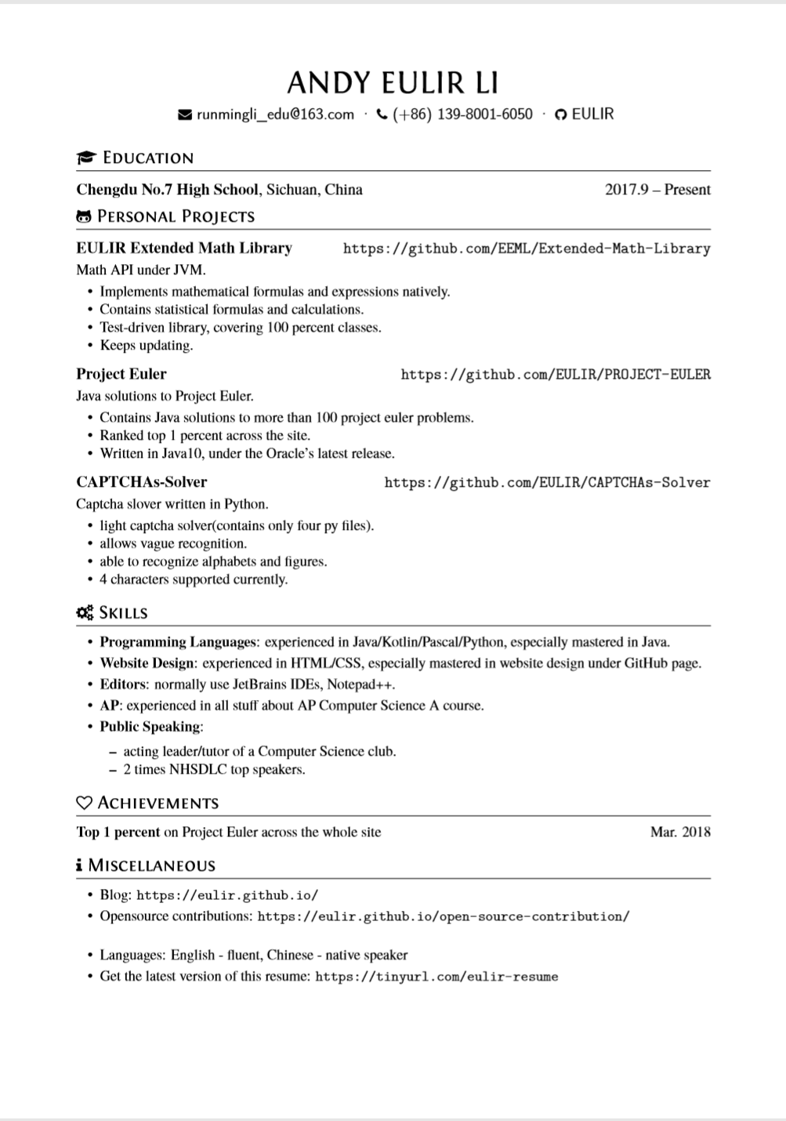
Download my résumé at
https://tinyurl.com/eulir-resume

Slide 11
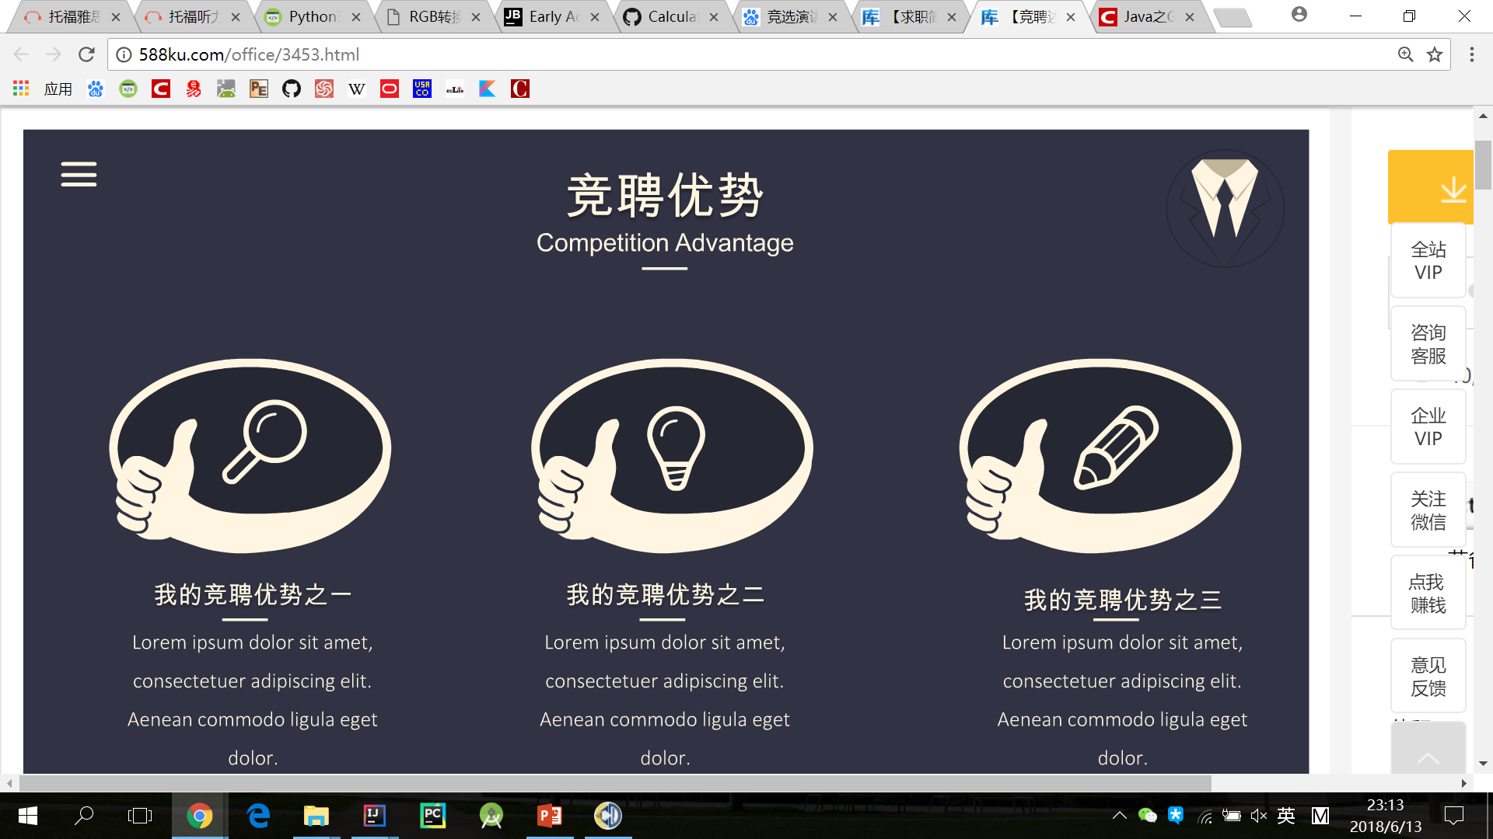
Competition Advantage
Knowledge and Information about Computer Science
Enthusiasm for Computer Science and optimism about the future of Computer Science
Experience of the leader of this Computer Science club

Slide 12
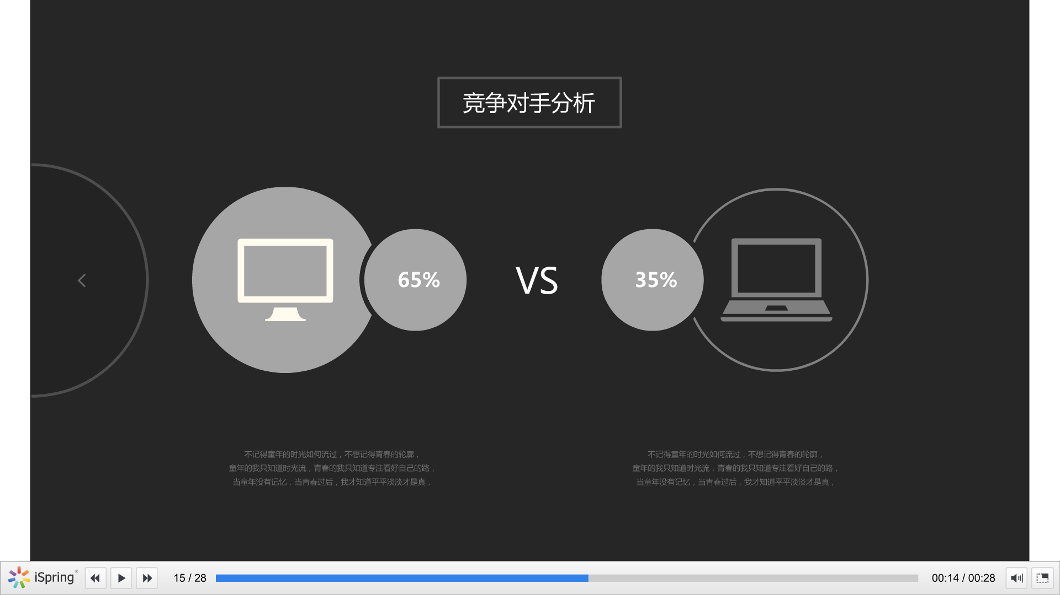
Club Contribution Analysis
Co-founders
Other club members
Other organizations
Andy Li
Class and Object course
Reference course
Recursion course
Sort course
Array course
Basic Structure course
Bitwise operation course
Club website design
Association recruitment presentation
…
AP lesson ---by a co-founder
Machine learning course ---by a co-founder
HTML course ---by a club member
The hour of code ---by a organization
Bluetooth car making ---by a organization

Slide 13
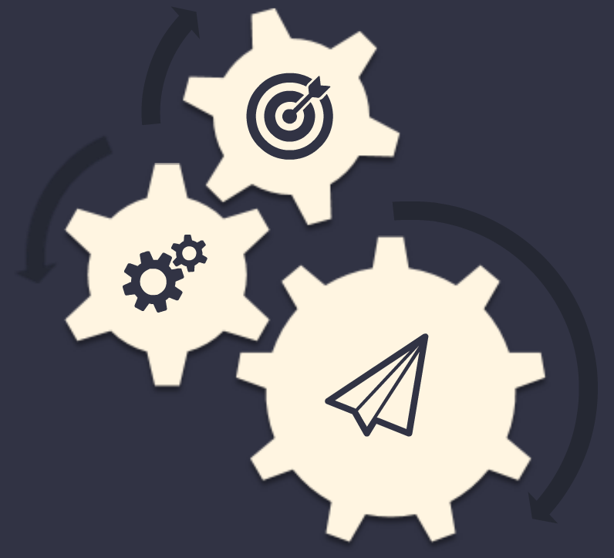
Job Planning
Regular courses
AP courses
Technical discussions
…

Slide 14
MAKE COMPUTER SCIENCE GREAT AGAIN

Slide 15
Thanks for listening
This work is licensed under a Creative Commons Attribution-NonCommercial-NoDerivs 2.0 Generic License.

